Slide 1
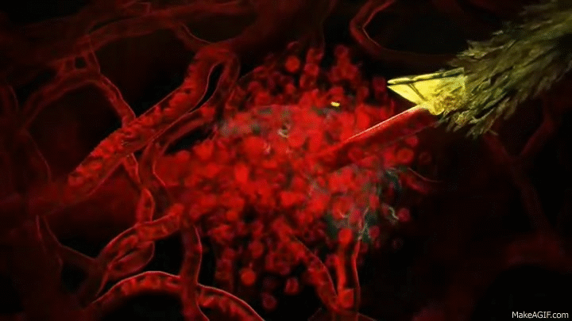
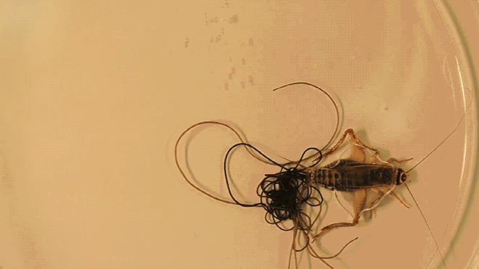
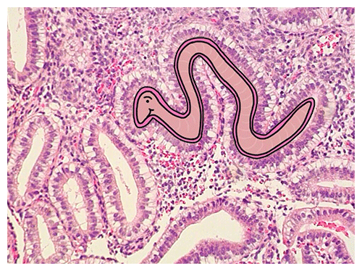
Anti-parasitic drugs

Slide 2


Slide 3


Slide 4
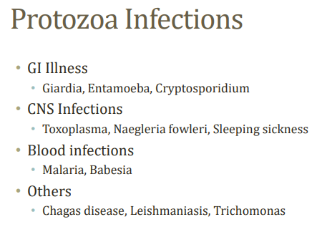

Slide 5
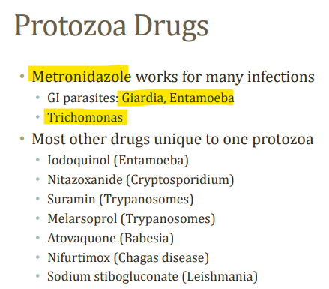

Slide 6

Metronidazole diffuses into the organism, inhibits protein synthesis by interacting with DNA,
and causes a loss of helical DNA structure and strand breakage.
Therefore, it causes cell death in susceptible organisms

Slide 7
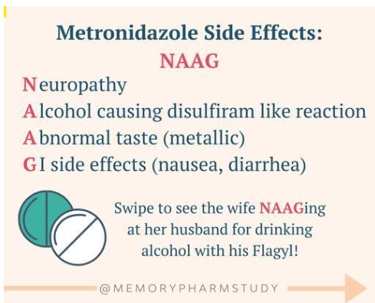

Slide 8


Slide 9
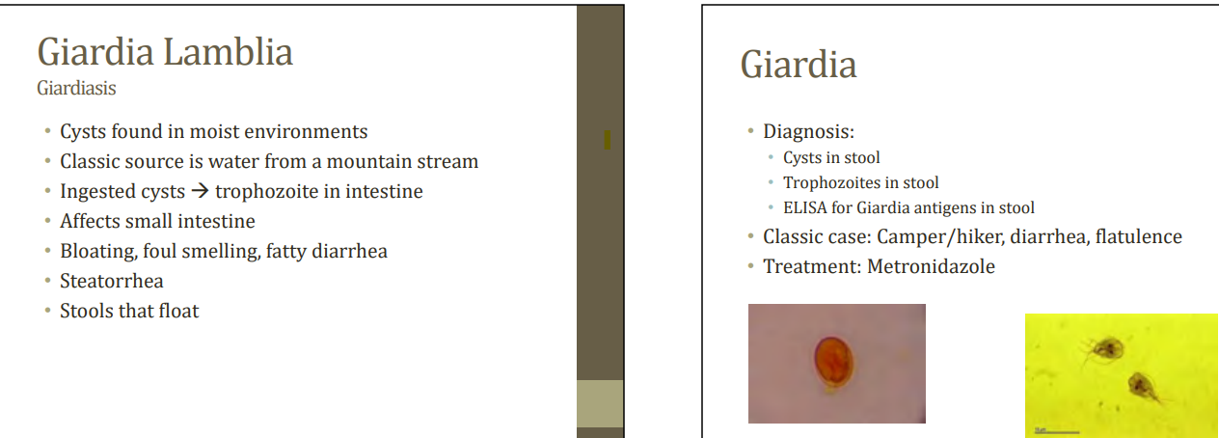

Slide 10


Slide 11
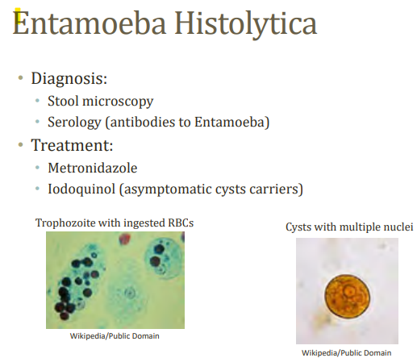

Slide 12
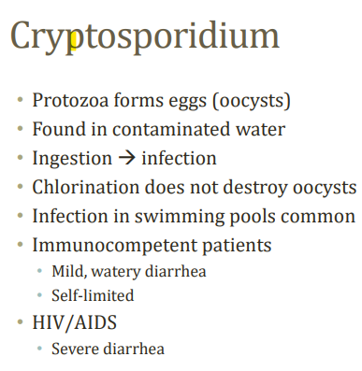

Slide 13
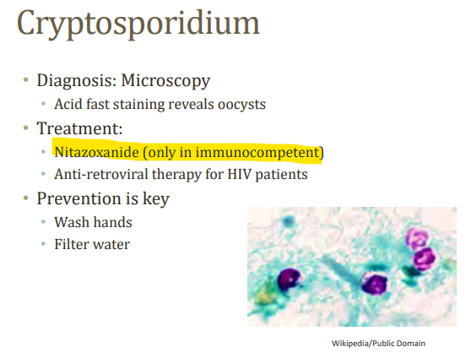

Slide 14
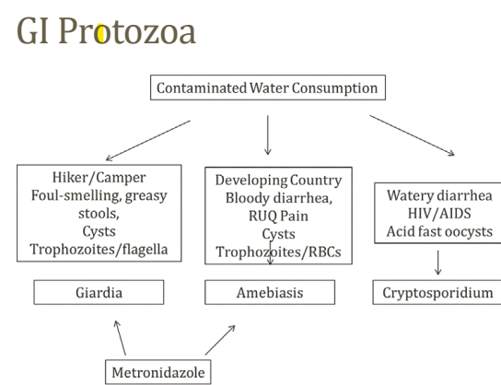

Slide 15
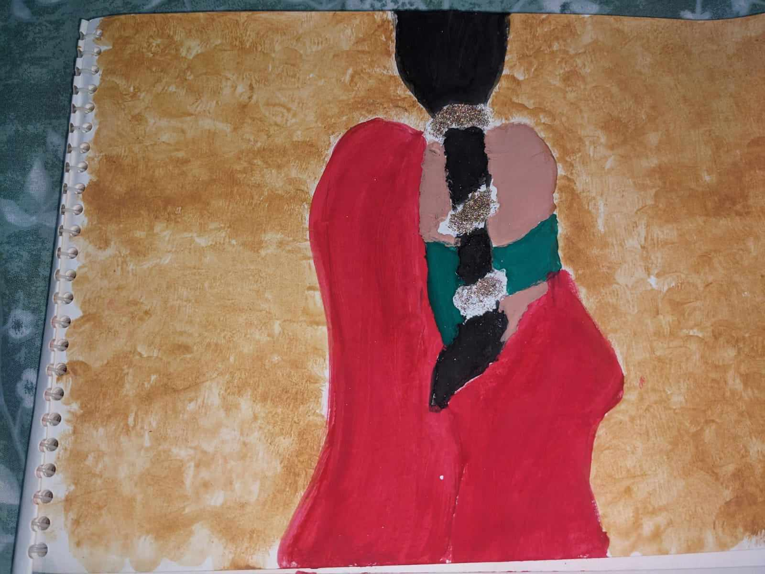

Slide 16
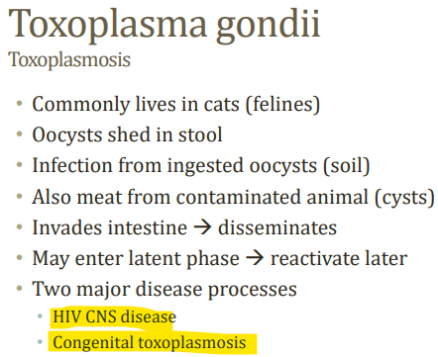
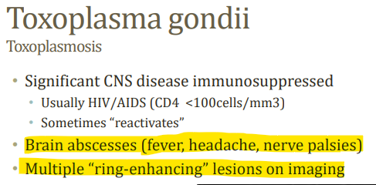

Slide 17
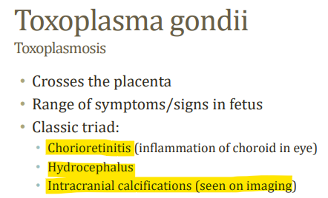
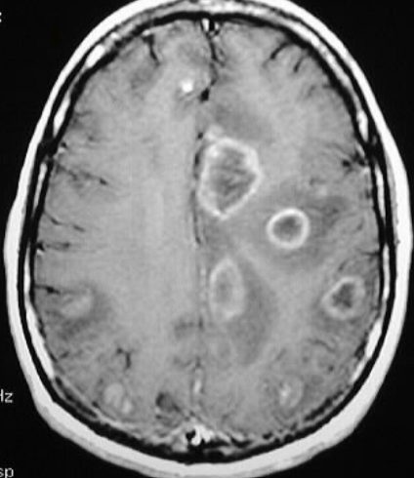
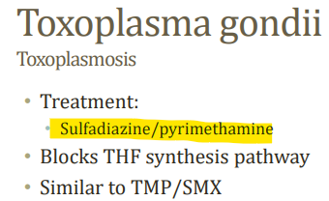

Slide 18
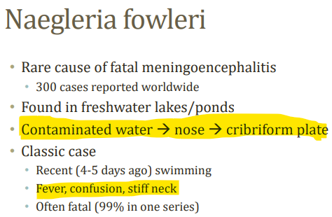

Slide 19


Slide 20
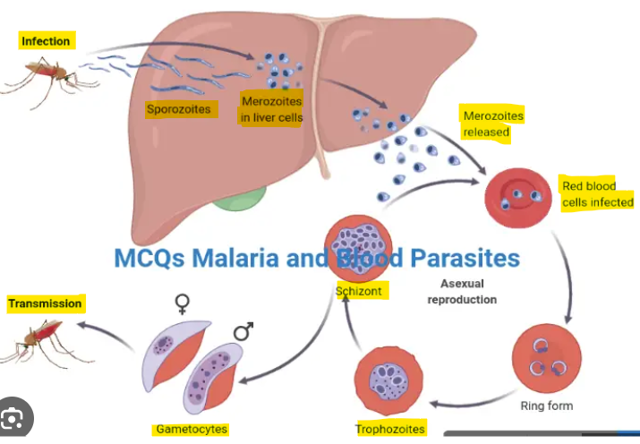

Slide 21
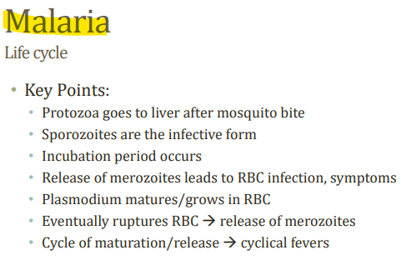

Slide 22
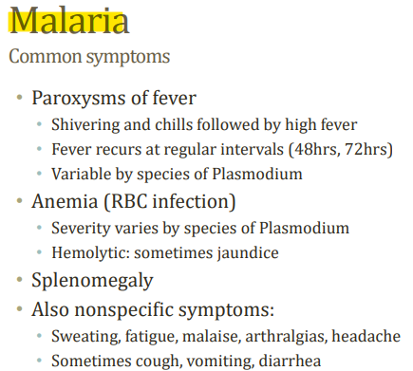

Slide 23
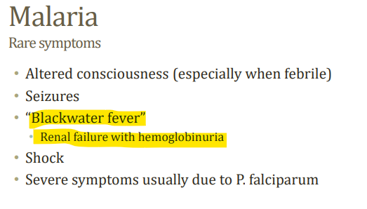

Slide 24
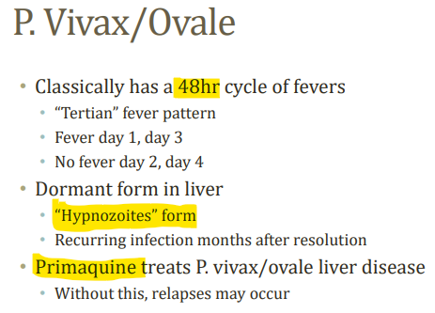
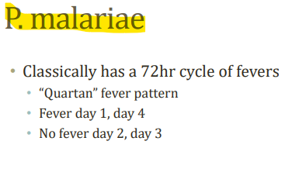

Slide 25
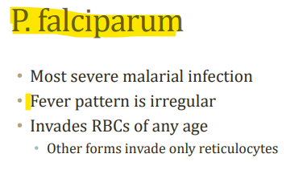
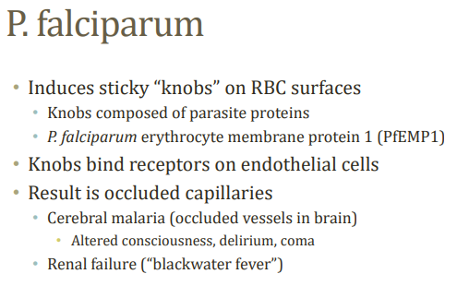

Slide 26
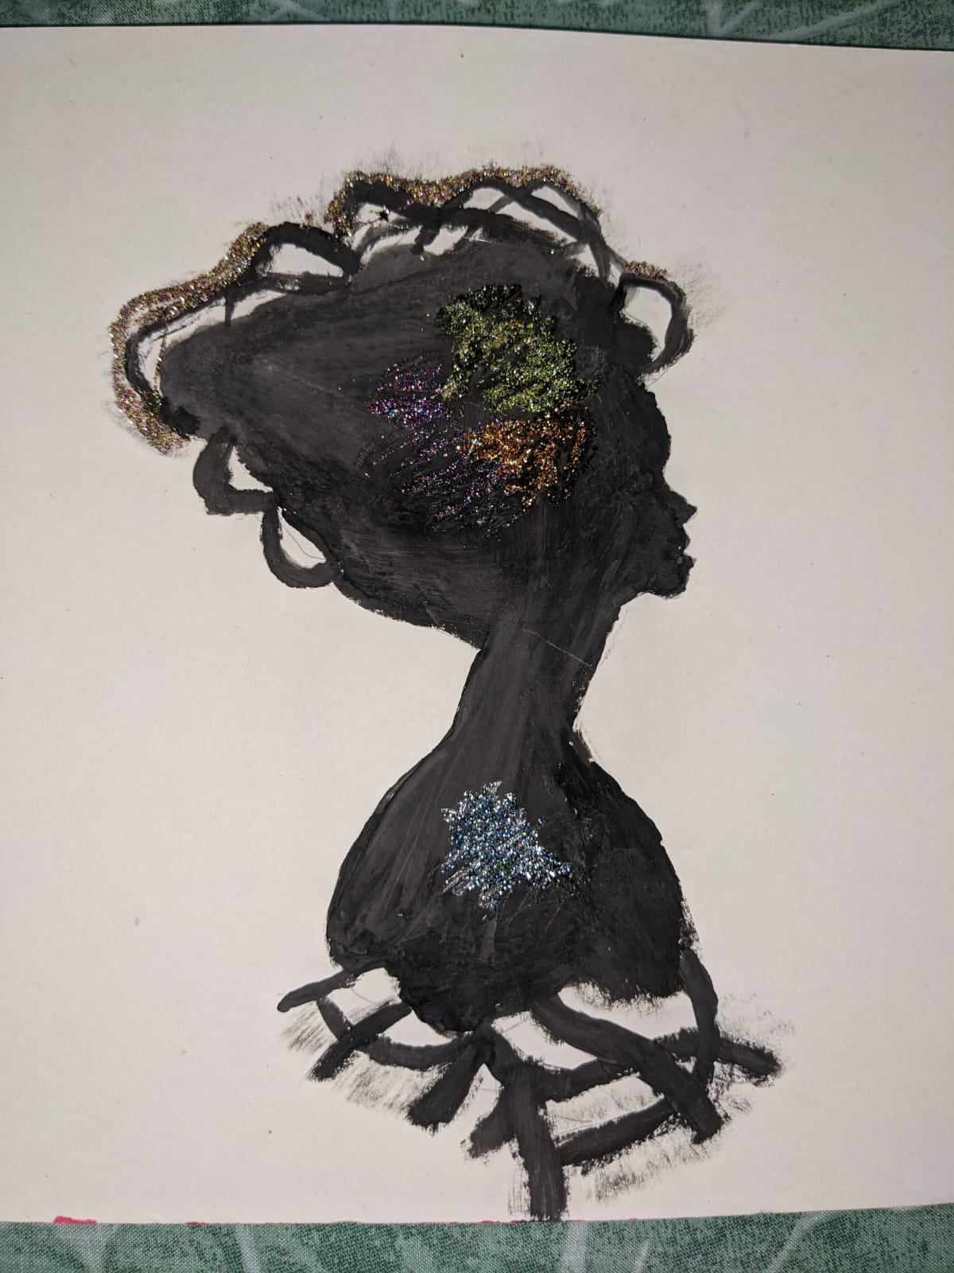

Slide 27
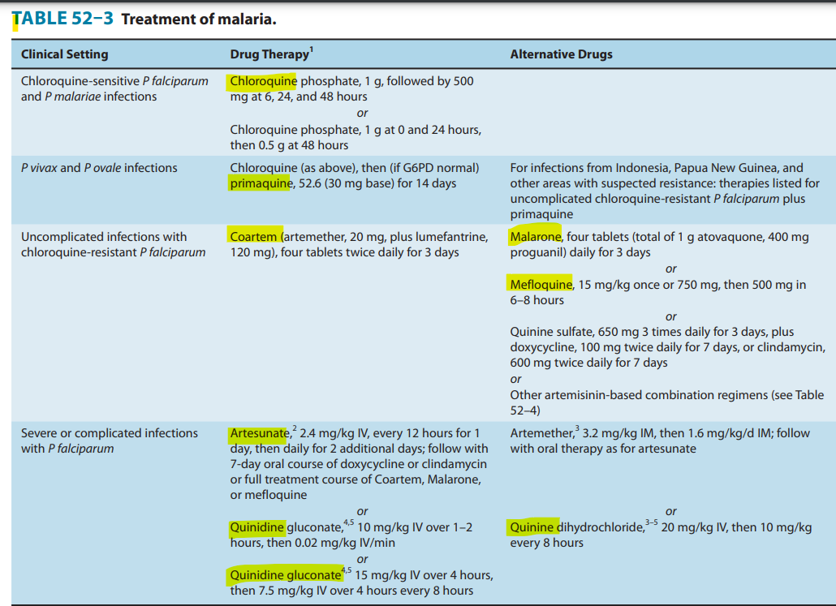

Slide 28
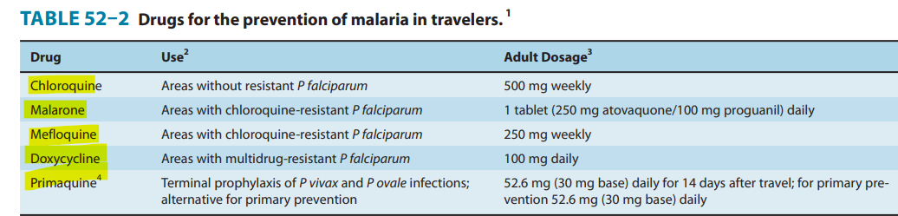

Slide 29
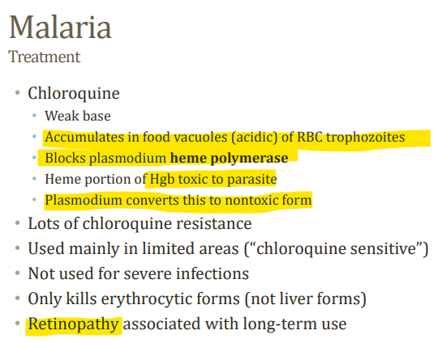

Slide 30
- Chloroquine is contraindicated in patients with psoriasis or porphyria, in whom it may precipitate acute attacks of these diseases.
-It should generally not be used in those with retinal or visual field abnormalities or myopathy.
-Chloroquine should be used with caution in patients with a history of liver disease
or neurologic or hematologic disorders.
-Chloroquine is considered safe in pregnancy and for young children.

Slide 31
Therapeutic dosages of quinine and quinidine commonly cause tinnitus, headache, nausea, dizziness, flushing, and visual disturbances, a constellation of symptoms termed cinchonism.
Mild symptoms of cinchonism do not warrant the discontinuation of therapy. More severe findings, often after prolonged therapy, include more marked visual and auditory abnormalities, vomiting, diarrhea, and abdominal pain.
Hypersensitivity reactions include skin rashes, urticaria, angioedema, and bronchospasm.
Hematologic abnormalities include hemolysis (especially with G6PD deficiency), leukopenia, agranulocytosis, and thrombocytopenia.

Slide 32


